Slide 1
Predicting Creditworthiness with Machine Learning
By
Philip Ng
Notes:
Hello, everyone! Today I will be presenting on the topic Predicting Creditworthiness with Machine Learning.

Slide 2
The Business Problem
Notes:
The Business Problem

Slide 3
To identify the key financial and demographic factors that influence creditworthiness, enabling the development of accurate predictive models and effective customer segmentation strategies to optimize lending practices, reduce credit risk, and improve targeting for financial products.
Notes:
To identify the key financial and demographic factors that influence creditworthiness, enabling the development of accurate predictive models and effective customer segmentation strategies to optimize lending practices, reduce credit risk, and improve targeting for financial products.

Slide 4
Data Import
Notes:
Data Import

Slide 5
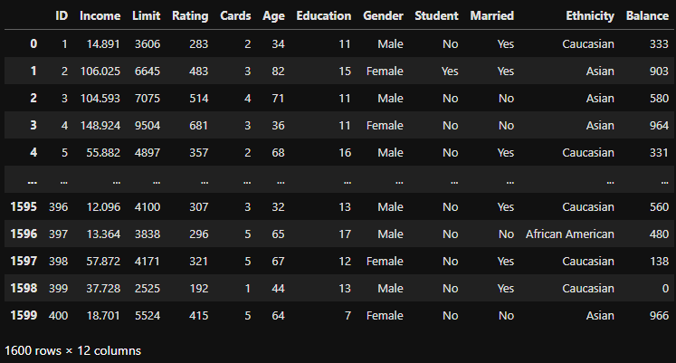
Data Source : https://www.kaggle.com/datasets/rassiem/credit-data
Notes:
We start with a dataset where the bank has given credit ratings for credit card applicants in the past. There are a total of 1600 records and 12 columns altogether. Considering data types, 7 columns are integers, 1 column is float and 4 columns are objects.

Slide 6
Attributes
Data Type
ID: A unique identifier for each individual. Integer
Income: The individual's annual income ($,000). Float
Limit: The credit limit assigned to the individual's credit card account. Integer
Rating: A credit rating score for the individual. Integer
Cards: The number of credit cards the individual possesses. Integer
Age: The age of the individual. Integer
Education: The number of years of education completed by the individual. Integer
Gender: The gender of the individual (Male/Female). Object
Student: Whether the individual is a student (Yes/No). Object
Married: The marital status of the individual (Yes/No). Object
Ethnicity: The ethnic background of the individual. Object
Balance: Balance (spendings) on the individual's credit card account. Integer
Notes:
These are the attributes. I have identified Rating as the driver leading the supervised machine learning.

Slide 7
What is Above_580 Rating ?
Here’s a quick breakdown of the CREDIT score RANGES:
Excellent : 800-850
Very Good : 740-799
Good : 670-739
Fair : 580-669
Poor : 300-579
Above 580 = Credit Worthy = 1
Below 580 = Not - Credit Worthy = 0
Notes:
Banks commonly use 580 as the threshold for what is considered a fair credit rating. I will consider scores at or above this threshold as credit worthy and those below as not be credit worthy.

Slide 8
Data Understanding
Notes:
Data Understanding

Slide 9
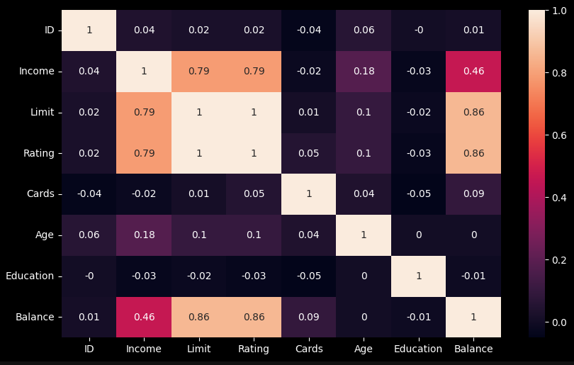


What drives Ratings?
Notes:
To help with feature selection, I turned to correlational analysis to find out what’s driving Ratings. By comparing Ratings with every other numerical factor I found that Income and Credit Card Balance are highly correlated with Rating. Number of cards held, age and education have very little or no correlation.

Slide 10
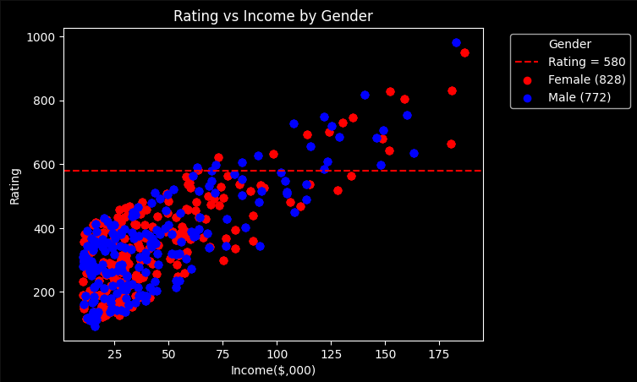
Notes:
I then plotted each applicants' Rating versus Income and added a line at Rating = 580 to examine the characteristics of the data both above and below this threshold. Applying the gender filter reveals a fairly balanced distribution of male and female applicants.

Slide 11
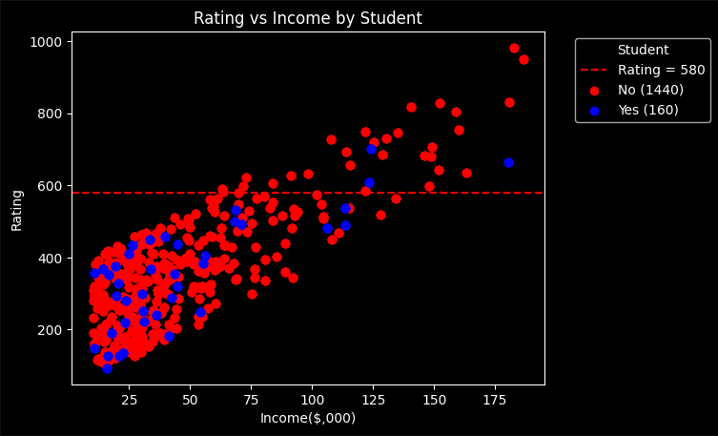
Notes:
This plot shows 90% of the applicants are non-students. This trend is also apparent above the 580 rating level, indicating that the bank is cautious about extending credit to students, who typically lack a regular income. Incorporating this feature into model training could significantly influence the machine learning outcomes.

Slide 12
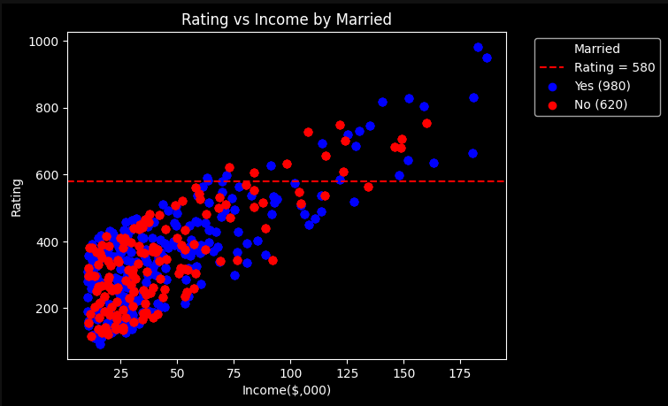
Notes:
This plot reveals a clear trend where married applicants show significantly higher incomes and ratings compared to unmarried applicants, whose incomes generally remain in the lower range between 10,000 and 50,000. Above the 580 Rating, there were also more married than unmarried applicants. This insight empowers the bank to explore underlying trends more thoroughly, using the information for strategic decision-making such as targeted marketing and loan approvals.

Slide 13
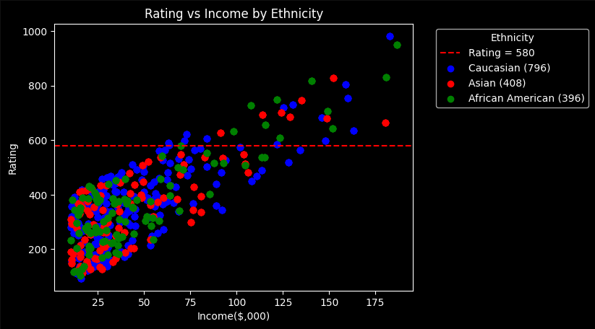
Notes:
This plot suggests that the bank's lending decisions are not influenced by ethnicity, as no clear pattern is present and the distribution across ethnic groups is uniform.

Slide 14
Data Preparation
Notes:
Next we come to Data Preparation

Slide 15
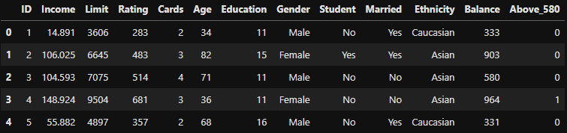
Target Encoding
1.
2.
Notes:
Instead of using linear regression to predict the rating, I will apply classification models. I created a new 'Target' column called Above_580, where applicants with a rating above 580 are labelled as 1 (creditworthy), and those below 580 are labelled as 0 (not creditworthy).

Slide 16
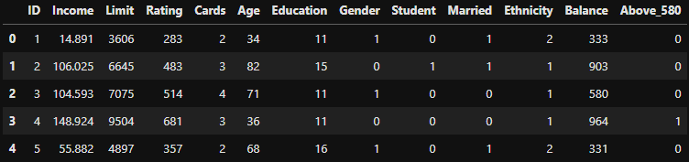
Label Encoding
2.
Notes:
Next, I converted the non-numerical columns to integers to prepare them for machine learning.

Slide 17
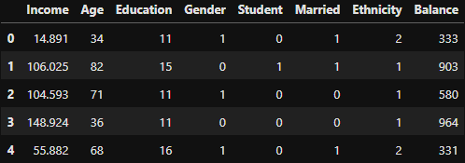
Feature Selection
Notes:
It's important to recognize that the types and number of features in this dataset are limited and not exhaustive. In practice, additional features could significantly improve the machine learning model. Such as Payment History, Car and Home Ownership, Mortgages and Loans, Loan Purpose, Number of Loan Applications and Residential Type, which are not found in this dataset.

Slide 18
Splitting the data to train and test sets
Split using Stratify
Above_580 | Train |  | Test
 | No. of rows | % | No. of rows | %
0 = Not-Credit Worthy | 1104 | 92 | 368 | 92
1 = Creditworthy | 96 | 8 | 32 | 8
Notes:
Next, I split the data into training and testing sets using stratification, ensuring that both sets maintain the original class distribution, where 92% were labelled as 0 and 8% were labelled as 1.

Slide 19
Data Modelling and Performance Evaluation
Notes:
Data Modelling and Performance Evaluation

Slide 20
Choosing the Right Model
Logistic Regression
K-Nearest Neighbor (KNN)
Support Vector Machine (SVM)
Decision Trees
Notes:
It is generally recommended to experiment with several models and use cross-validation to identify which works best for a specific dataset.

Slide 21
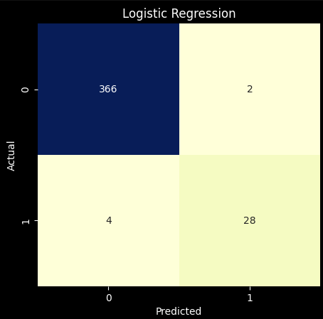
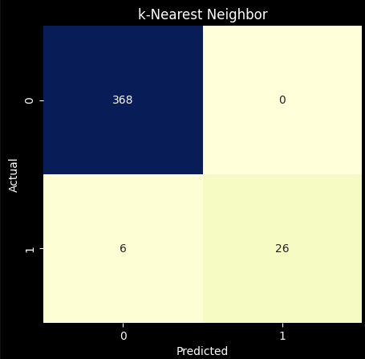
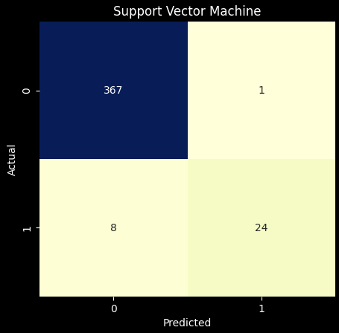
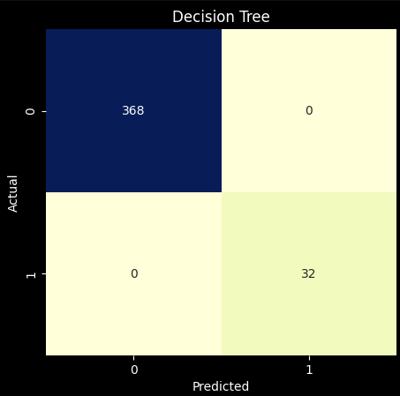
TN
FP
TN
FP
FN
TP
FN
TP
Confusion Matrix
TN
FP
TN
FP
FN
TP
FN
TP
Notes:
The model training results indicate that Decision Tree (at bottom-right) achieved the best confusion matrix, accurately predicting all 32 TP with 0 FN, Logistic Regression had 4 FN, KNN had 6 FN, and Support Vector Machine had 8 FN. Decision Tree also accurately predicted all 368 TN with 0 FP, KNN also had 0 FP, Support Vector Machine had 1 FP, and Logistic Regression had 2 FP. KNN, Support Vector Machine and Logistic Regression are all better at predicting the negative class. This is probably due to an imbalance dataset.

Slide 22
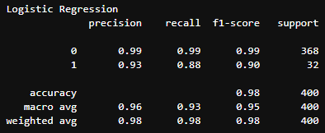
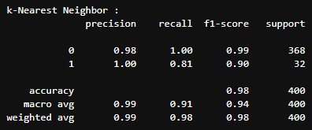
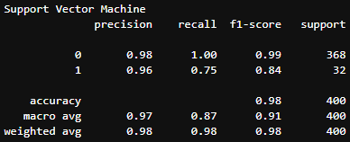
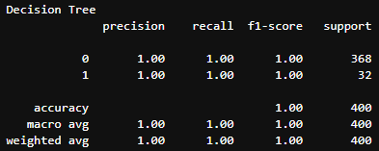
Classification Report
Notes:
A relatively low recall for the positive class compared to the negative class can have serious implications in various industries. For example, in healthcare, a cancer patient could be incorrectly diagnosed as cancer-free. Similarly, in my case, a creditworthy individual might be misclassified as not creditworthy, causing the bank to miss the opportunity to serve a potentially high-net-worth client. I propose two methods to improve the recall of the positive class: first is hyperparameter tuning, and second is oversampling, which involves increasing the number of instances in the minority class by duplicating existing rows until both classes are balanced.

Slide 23
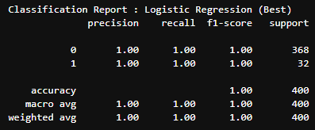
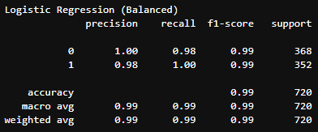
Comparing Logistic Regression with Hyperparameter Tuning and Oversampling
Notes:
The bottom-left model is configured with the best hyperparameters, while the bottom-right has been trained using oversampling. The green circle shows that the size of the positive class has increased due to duplication. Both models show a significant improvement in recall compared to the original model on the top-right.

Slide 24
Learning Curve : Overfitting vs Underfitting
Accuracy
Training
Validation
Training Size
Underfitting
Good Fit
Overfitting
Notes:
Learning Curve. Overfitting happens when the training score is much higher than the validation score, meaning the model performs well on the training data but poorly on test data. Underfitting occurs when both scores are low, meaning that the model performs poorly on both the training and test data.

Slide 25
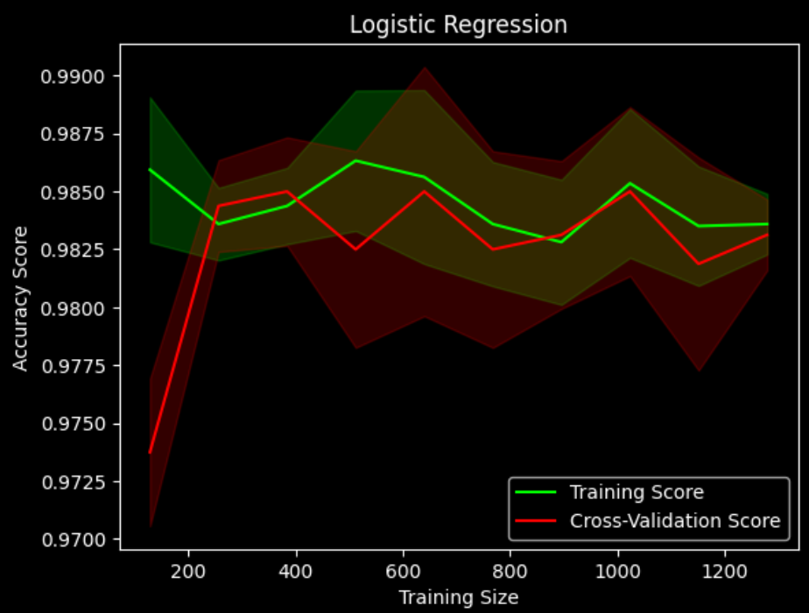
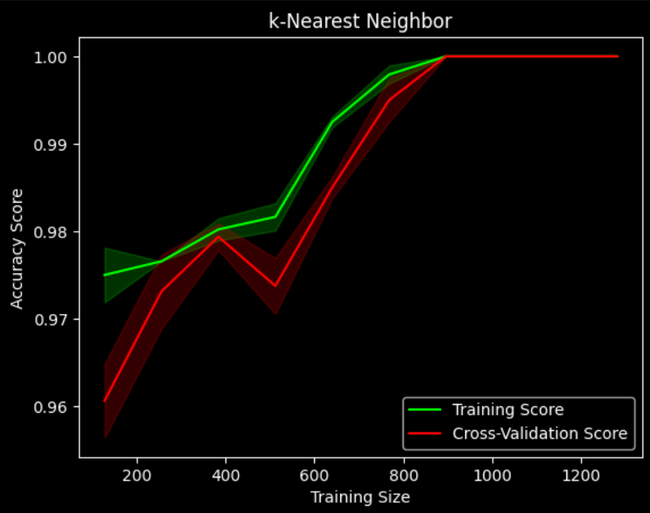
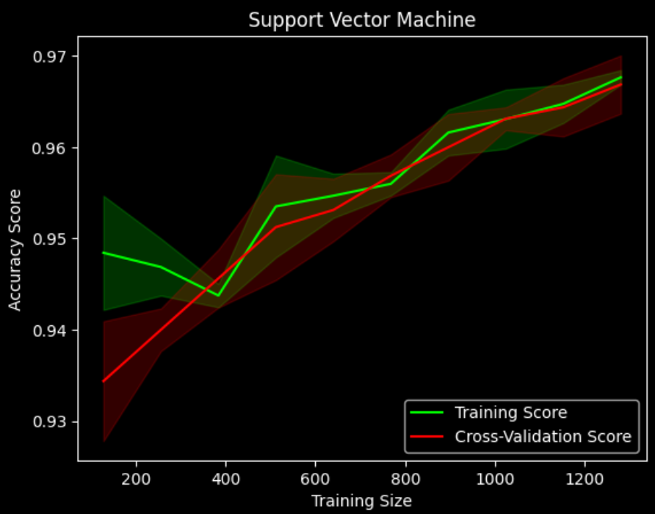
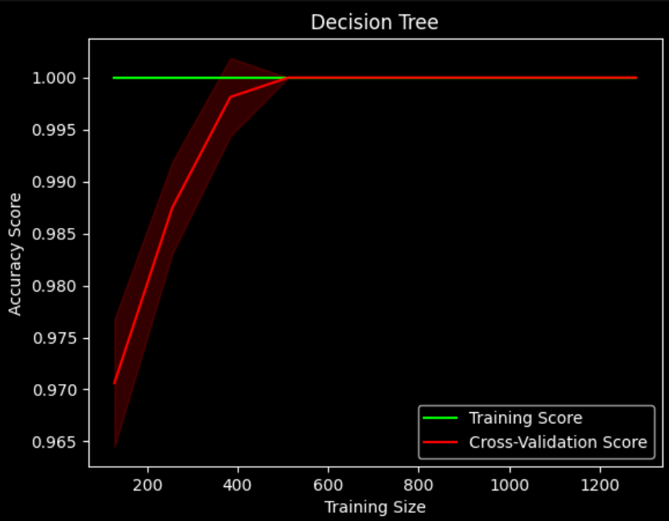
Comparison by Learning Curve
Notes:
Decision Tree appears to be the best model in this scenario due to its high training and cross-validation scores, indicating both good fit and generalization capabilities. Good Fit means that the model fits the training data well and captures the underlying patterns in the data accurately. Generalization capabilities means that it performs well on test data and is able to apply the patterns it has learned to new data. Logistic Regression, Support Vector Machine and KNN also perform well as data increases.

Slide 26
ROC (Receiver Operating Characteristic) Curve :
1.0
ROC Curve
Threshold
True Positive Rate (Recall)
AUC (Area Under Curve)
Random Guessing
0.0
False Positive Rate
1.0
Notes:
The ROC Curve represents the various confusion metrics plotted for all possible thresholds. The AUC is the entire area underneath that curve. It provides a measure of how well the model can distinguish between the positive and negative classes for all possible thresholds. It is often used when comparing different classification models. A model with a higher AUC is generally considered better at distinguishing between classes.

Slide 27
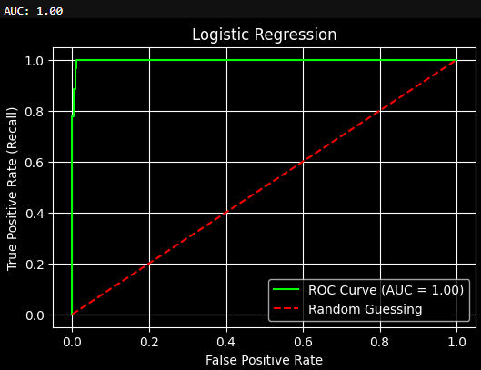
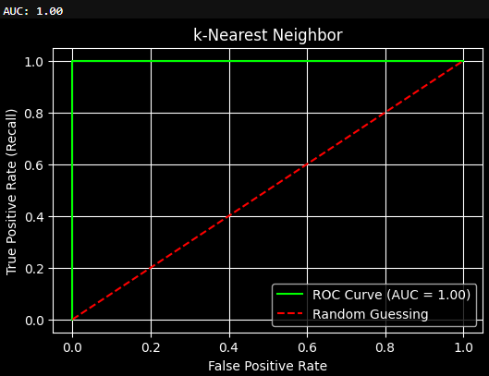
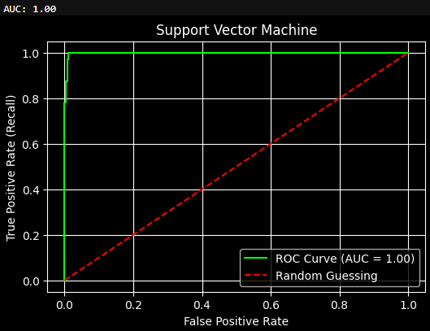
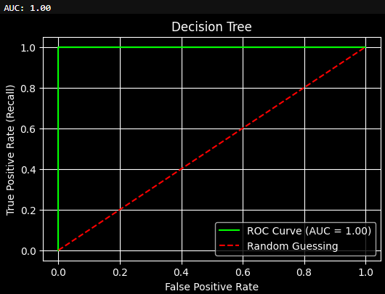
Comparison by ROC Curve
Notes:
All four models have perfect AUC score of 1. The red circle indicates the optimal threshold where recall for the positive class is 1. When the false positive rate on the x-axis is 0, recall for the negative class will also be 1, meaning that the model can perfectly distinguish between the two classes with no FN and FP.

Slide 28
Logistic Regression
k-Nearest Neighbour
Pros
Cons
Pros
Cons
Easy to interpret
Scalable
Speed
Large dataset
Accuracy struggles when the data is highly non-linear or complex.
Simple
Intuitive
Easy to understand
Lacks interpretability
Slow with large dataset
Sensitive to imbalanced data
SWOT Analysis
Support Vector Machine
Decision Tree
Pros
Cons
Pros
Cons
Work well for complex, non-linear data with proper tuning
Easy to interpret
Large dataset
Can model complex relationships
Tends to overfit
Computationally intensive
Lacks interpretability
Can be slow and expensive with large datasets
Notes:
In practical applications, we may want to weigh performance metrics alongside model complexity and efficiency to determine the best model. Interpretability refers to the extent to which a human can understand how a model makes decisions. It is important in fields like finance, healthcare, and law, where understanding the reasoning behind a model’s predictions is crucial for trust, accountability, and regulatory compliance. While Decision Tree shows excellent performance, it’s also essential to consider efficiency. Especially with larger datasets, Decision Trees may be computationally intensive and prone to overfitting. Logistic Regression is generally better suited for very large datasets due to its scalability and speed, especially when the relationships in the data are expected to be linear. Support Vector Machine works well for complex and non-linear data, however, it can be costly with large datasets, and it lacks interpretability. KNN is simple and easy to understand but it can be slow with large datasets due to distance calculations.

Slide 29
Best model for predicting creditworthiness :
Logistic Regression
Notes:
After evaluating the model performance metrics and considering factors such as model interpretability, complexity and efficiency, the decision was made to select logistic regression.

Slide 30
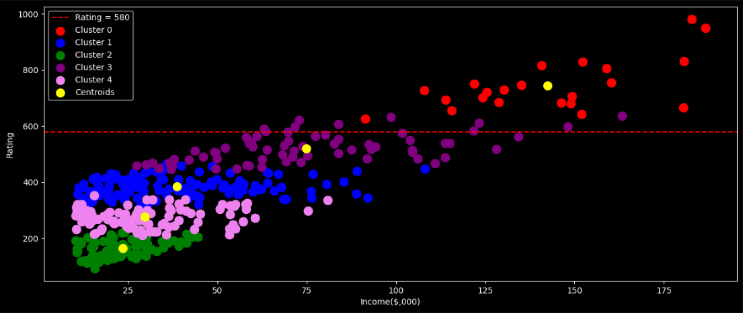
K-Means Clustering for Market Segmentation
Notes:
Finally, K-Means Clustering can help in identifying key groups that might need different credit offerings. For example, higher-income individuals in Cluster 0 may be eligible for premium financial products, while those in lower-income clusters may need basic products focused on financial stability. With this, I end my presentation.

Slide 31
Thank You !

